Slide 1





Personal Finance Assistant
Team:
Jahnavi Vallepalli
Dhatrija Sukasi

Slide 2

Introduction
Personal Finance Assistant is designed to help users track their spending, categorize expenses, optimize their budgets, and detect fraudulent transactions in real time. This intelligent system leverages AWS Cloud Services to: process financial data providing users with actionable insights through machine learning. By utilizing AWS Comprehend for transaction categorization, Matpltlib local for spending predictions, and AWS Lambda, SNS and IAM for fraud detection alerts, this assistant empowers users to make informed financial decisions while ensuring security and efficiency.

Slide 3
Scope of the Project
Expense Categorization – Automatically classify transactions into categories like groceries, rent, and entertainment using AI.
Spending Pattern Analysis – Track user spending habits over time and provide personalized budgeting insights.
Fraud Detection & Alerts – Identify unusual transactions and send real-time alerts for potential fraud.
Predictive Analytics – Forecast future spending trends using machine learning models.

Slide 4

Data used for this project
Transaction analysis dataset
Data
Columns present in this dataset:
Date
Description(Ex: Amazon, Spotify, Shell..)
Amount
Transaction(Ex:Credit or Debit)
Account Name(Ex: Checking, silver card..)
Fraud Detection Analysis
Columns present in this dataset:
Time
V1...V28(PCA Dimensionality reduction to protect user identities and sensitive features)
Amount
Class(0-not fraudulent, 1- fraudulent)

Slide 5

FEATURES IMPLEMENTED

Slide 6
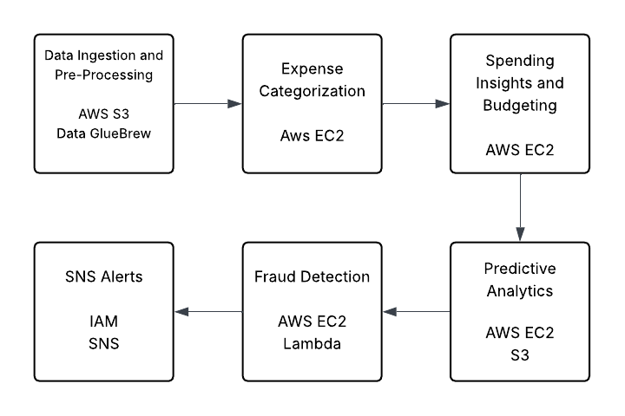

Slide 7
Data Ingestion and Data Preprocessing
Uploaded raw datasets personal_transactions.csv and creditcard.csv to S3 bucket.
Cleaned data using AWS Glue DataBrew: fixed dates, dropped missing values, converted categories to numeric, standardized column names.
Exported cleaned datasets back to S3 — no manual EC2 processing needed.

Slide 8
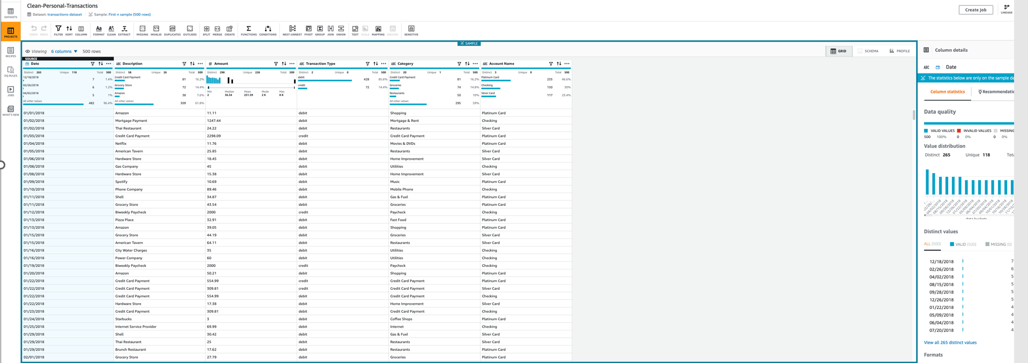

Slide 9
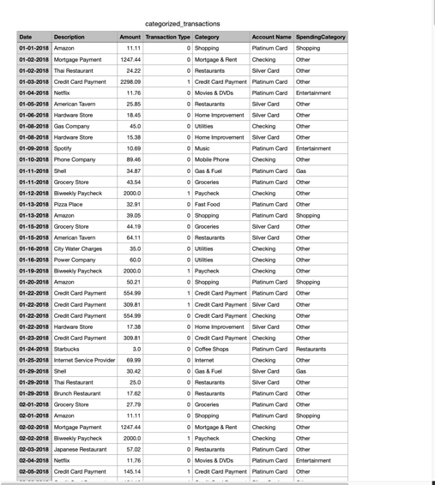
Expense Categorization
Launched EC2 instance to run Python-based categorization script
Leveraged AWS Comprehend for entity detection from transaction descriptions
Mapped transactions to categories (e.g., Amazon → Shopping, Shell → Gas)
Saved output as categorized_transactions.csv in S3

Slide 10
Spending Insights and Budgeting
Analyzed spending patterns locally using Matplotlib
Grouped transactions by spending category and summed total amounts
Created bar graphs to visualize category-wise spending
Saved spending insights as .png image files for reporting

Slide 11
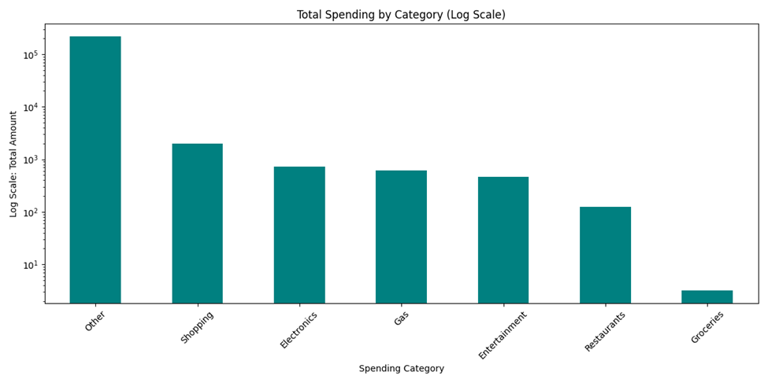

Slide 12
Predictive Analysis
Trained a Linear Regression model to forecast next month’s spending
Features used: Day of Week, Previous Spending, and Category
Saved and uploaded the model (spending_model.pkl) to S3
Visualized predicted spending across categories with a bar graph

Slide 13
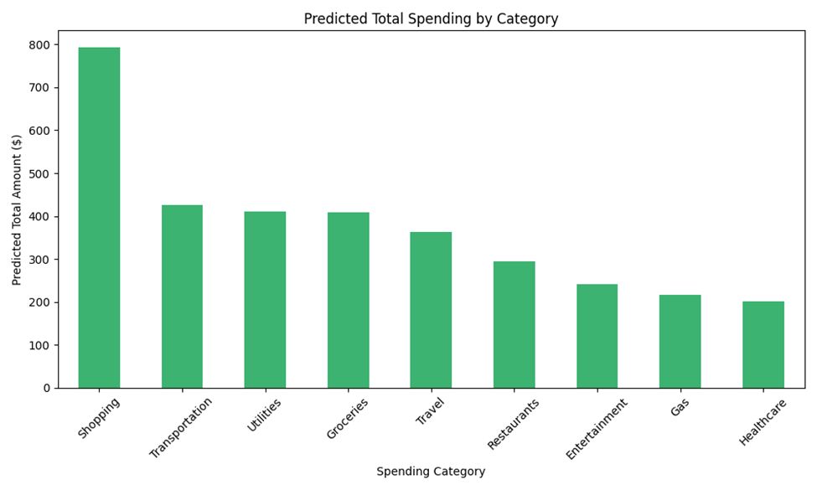

Slide 14
Fraud Detection
Trained Random Forest Classifier on ExportCleanedCreditcard.csv
Saved the trained model as fraud_model.pkl and uploaded to S3
Initially attempted AWS Lambda for deployment but exceeded size limit due to dependencies
Switched to local MacBook setup for fraud detection due to size constraints
Wrote and ran predict_fraud.py locally to predict fraudulent transactions
Loaded fraud_model.pkl and used Python to detect fraud without using AWS SageMaker or Lambda

Slide 15
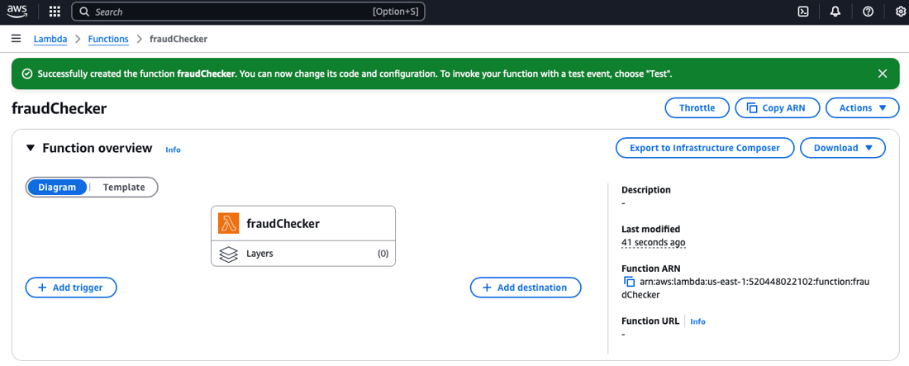

Slide 16
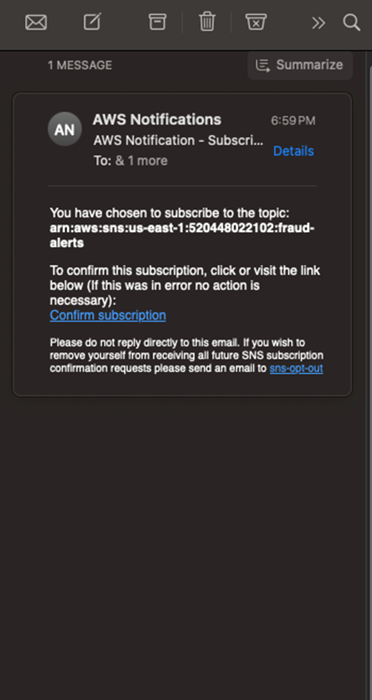
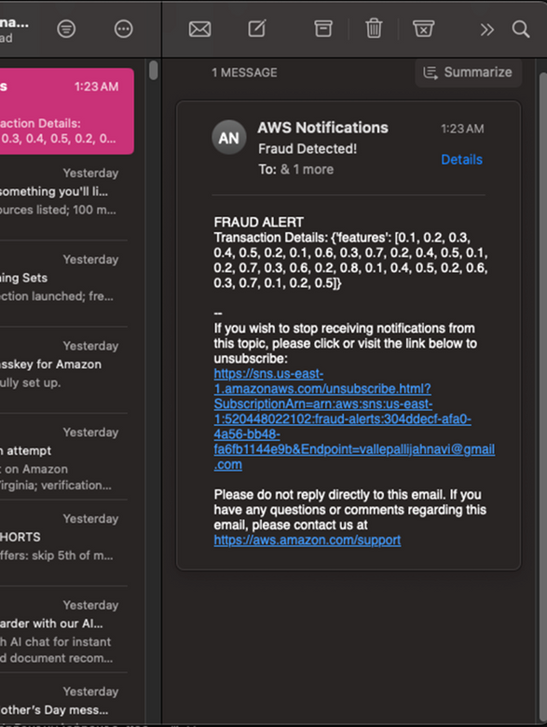
SNS Alerts
Created IAM user with Programmatic Access
Attached AmazonSNSFullAccess policy
Generated Access Key ID and Secret Access Key for boto3 usage
Created SNS Topic fraud-alerts
Subscribed personal email to topic
Confirmed subscription via email
Ready for Alerts: Fraud alerts can now be received

Slide 17

Thank You

